Slide 1
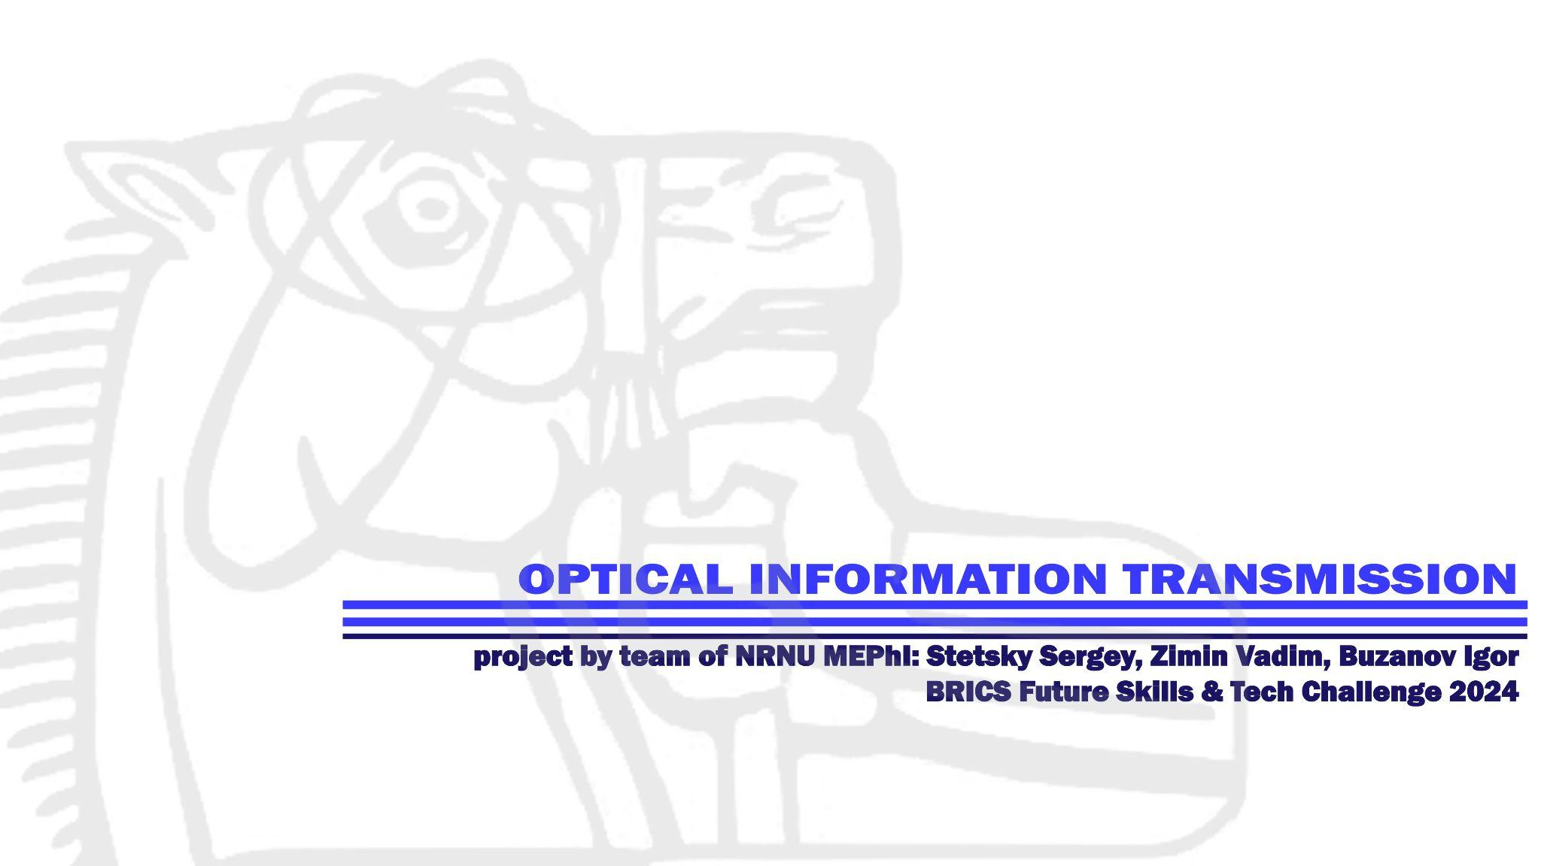

Slide 2

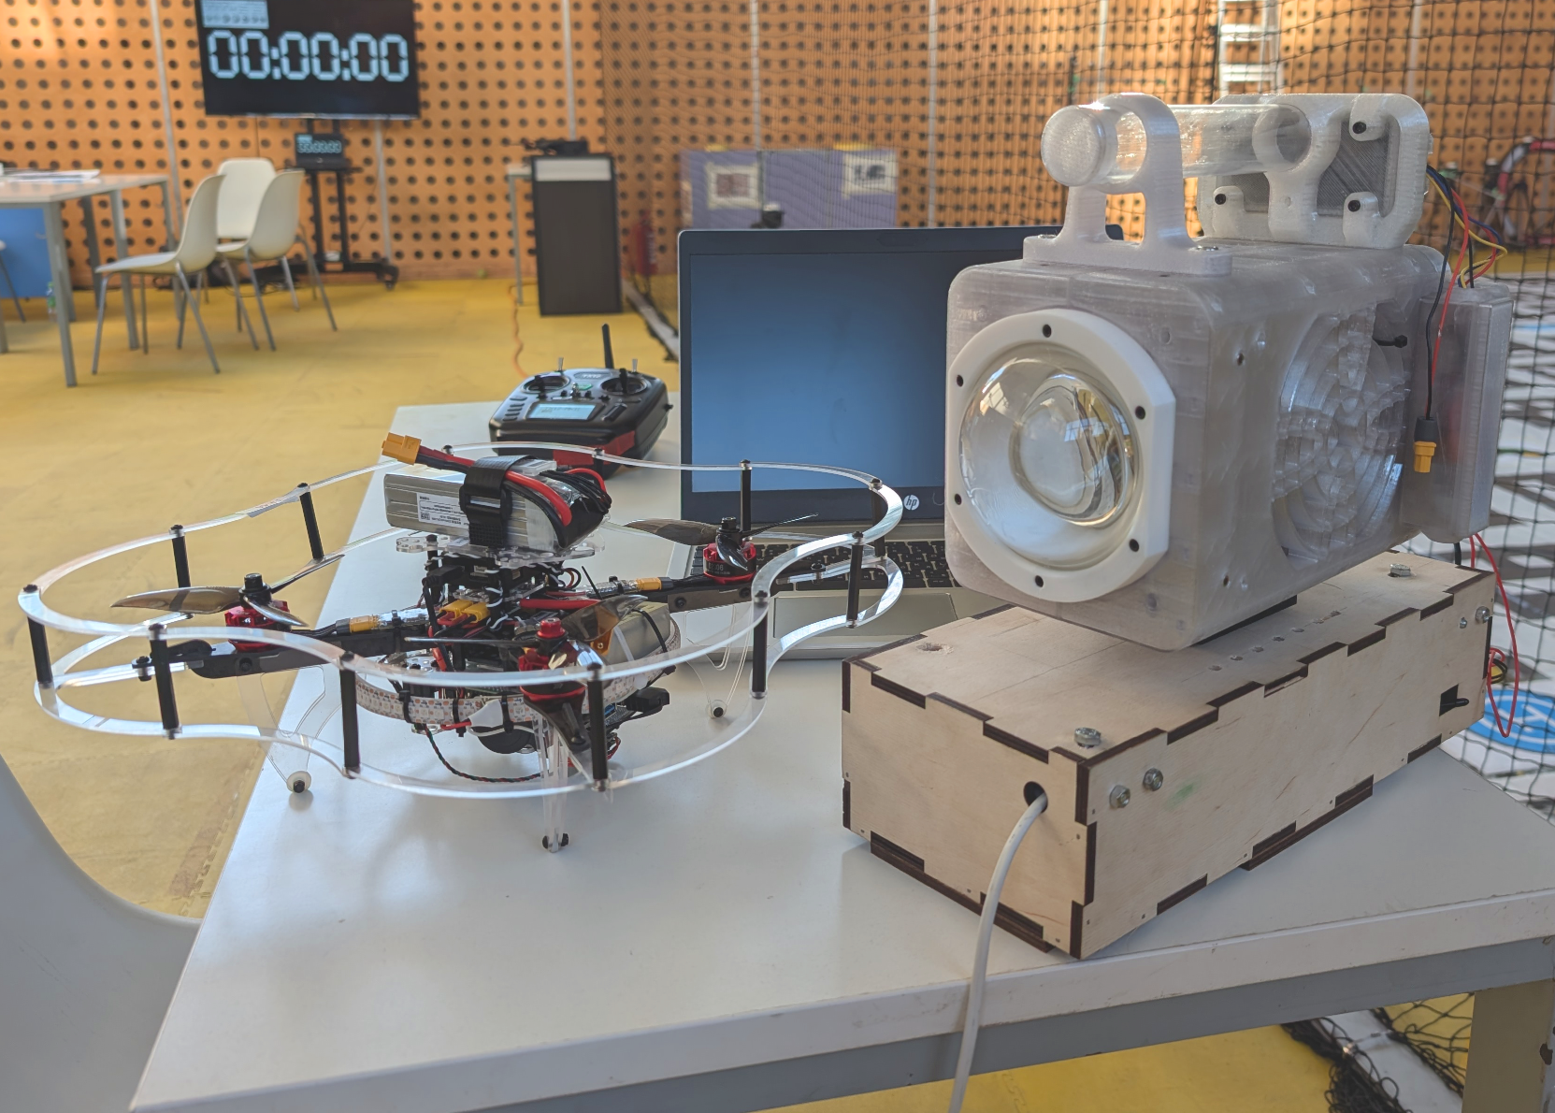
THE KEY IDEA
Communication via radio waves is highly susceptible to outside influence.
The transition to optical communication allows you to completely eliminate the third-party factor.

Slide 3
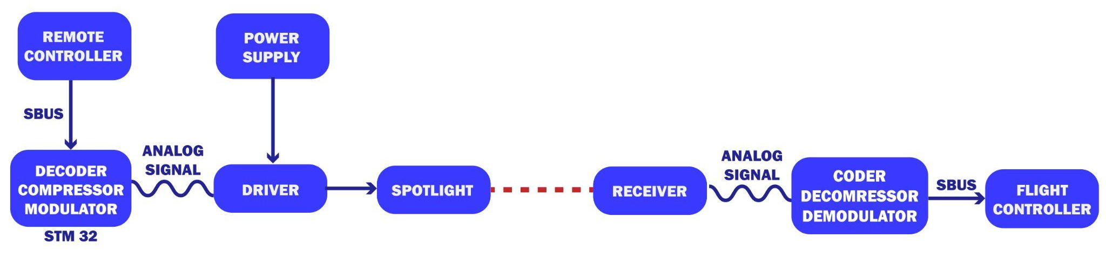
TECHNICAL COMPONENT

Slide 4
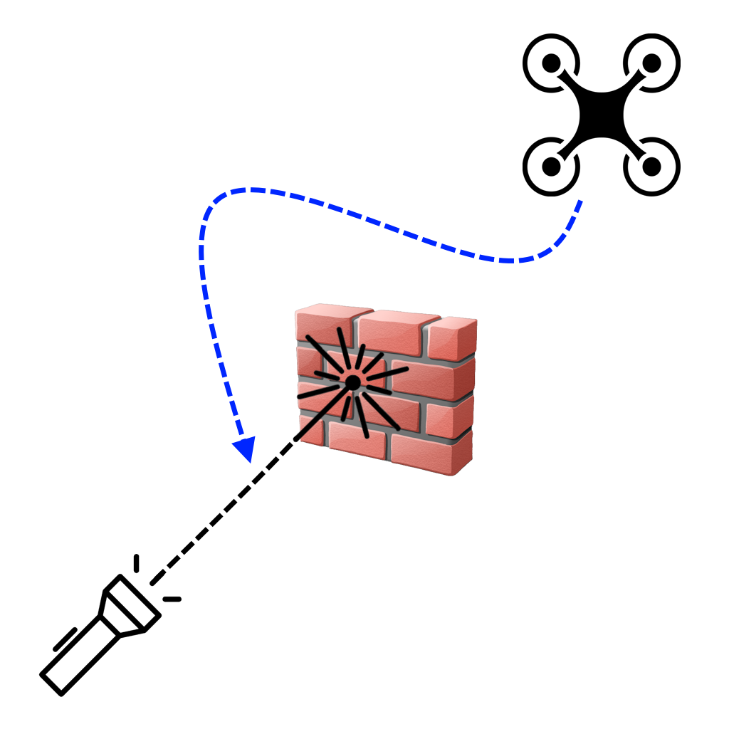
FAILSAFE MECHANISM
In case an obstacle blocks the optical signal, the drone may lose control.
To prevent this, the system is designed to periodically save the drone's current coordinates.
If the signal is lost, the drone will retrace its path until the connection is restored.

Slide 5
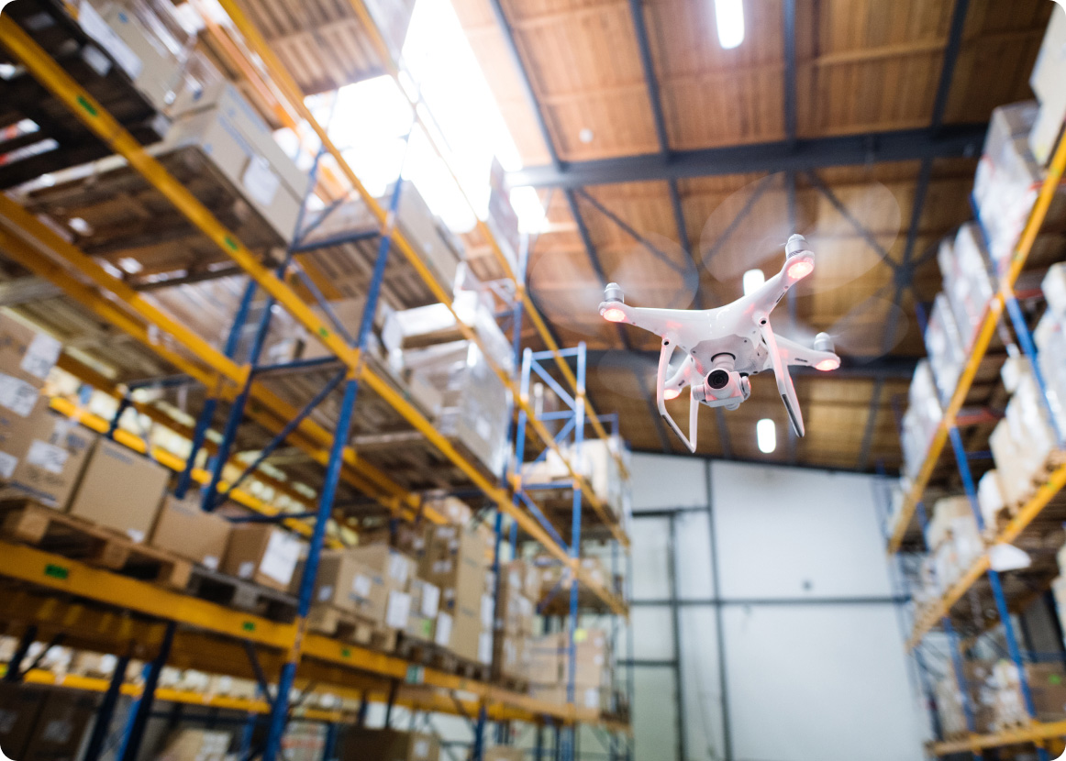
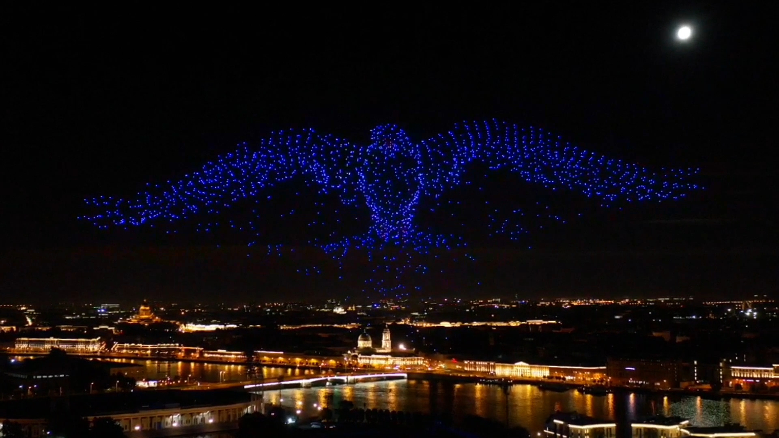
MARKET ANALYSIS
The drone usage in enclosed spaces
Scenarios for controlling a large number of drones
Situations where radio communication is difficult or impossible
Circumstances when radio waves are heavily overloaded or unconventional

Slide 6
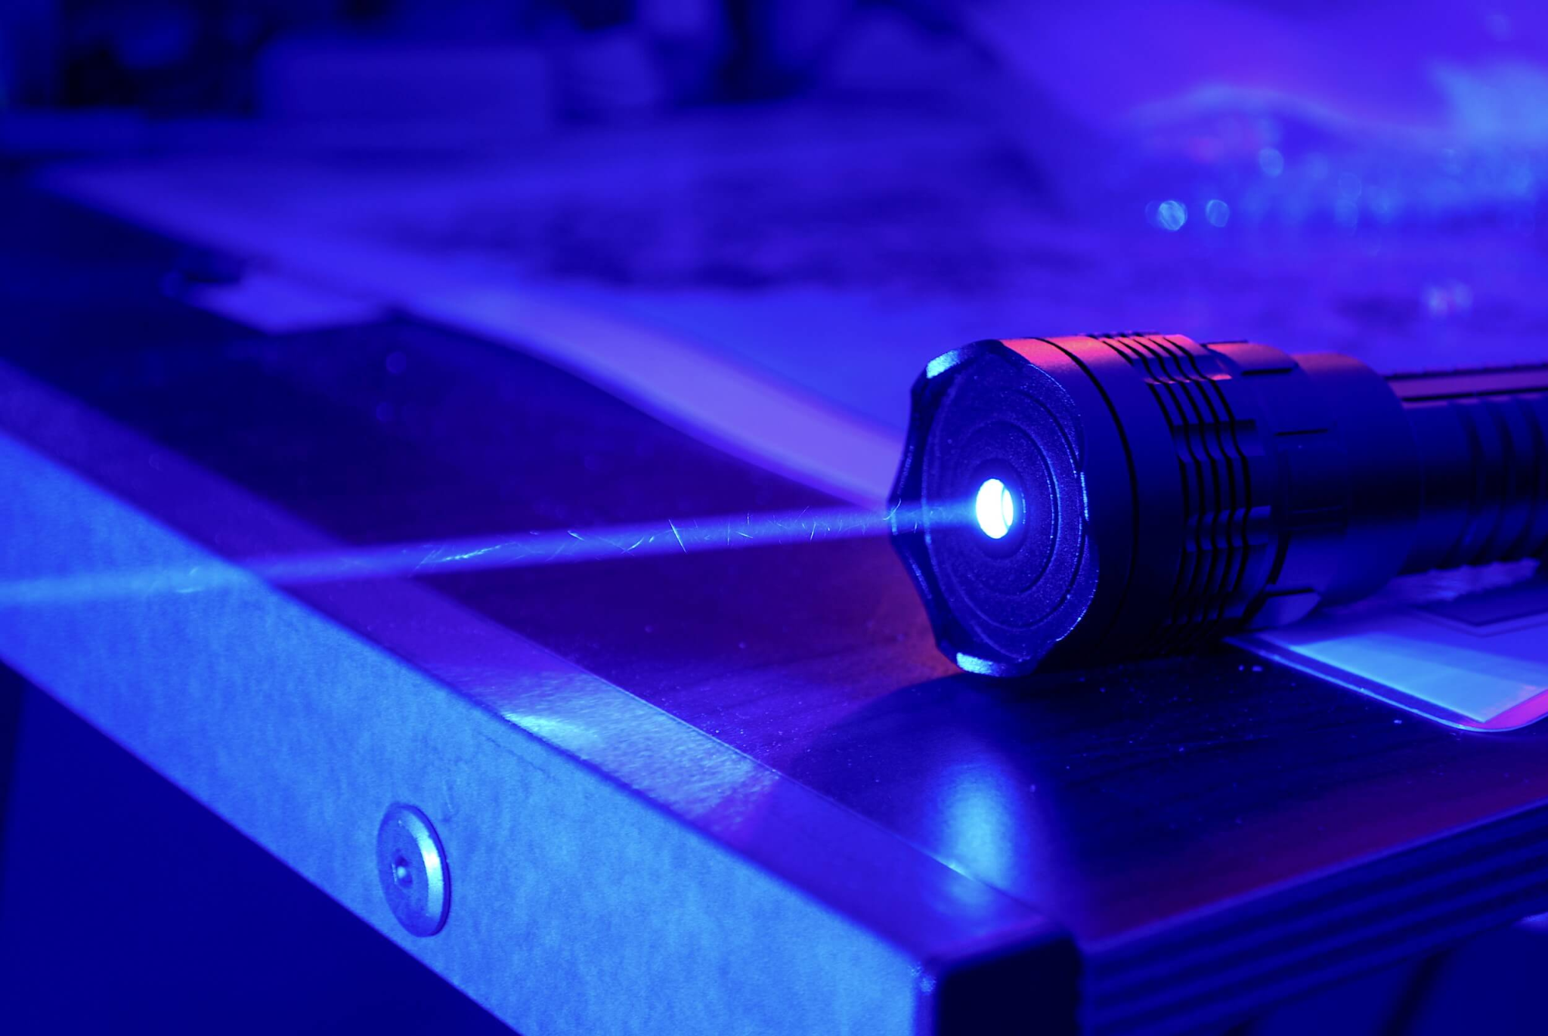
DEVELOPMENT PROSPECTS
Increasing the bandwidth of the communication channel
Introduction of two-way communication
Adaptation of the technology for lasers
Introduction of the different light spectres and waveforms

Slide 7
THANK YOU FOR YOUR ATTENTION!
Come join lasers with us!

